Slide 1
Concurrency Control

Slide 2
Concurrency Control
What/Why is concurrency control?
Shared Resources?
Protection
Mutual Exclusion
Critical section
Synchronization
Tools
Semaphore
Binary Semaphore
Issues
Deadlock
Starvation
Data Coherency

Slide 3
Multithreading
#include <pthread.h>
#include <unistd.h>
void * even(void * ptr)
{ int i;
for (i = 0; i < (int)ptr; i+=2){ printf("%d", i) ; usleep(100); }
pthread_exit(0);
}
int main(int argc, char ** argv)
{
pthread_t t0 , t1;
pthread_create(&t0, 0, even, (void *)50);
pthread_create(&t1, 0, odd, (void *)100);
pthread_join(t0, 0);
pthread_join(t1, 0);
return 0;
}
int pthread_create(pthread_t *thread, const pthread_attr_t *attr, void *(*start_routine) (void *), void *arg);
int pthread_join(pthread_t tid, void **ret); … void pthread_exit(void *ret);
void * odd(void * ptr)
{ int i;
for (i = 1; i < (int)ptr; i+=2){ printf("%d", i) ; usleep(100); }
pthread_exit(0);
}

Slide 4
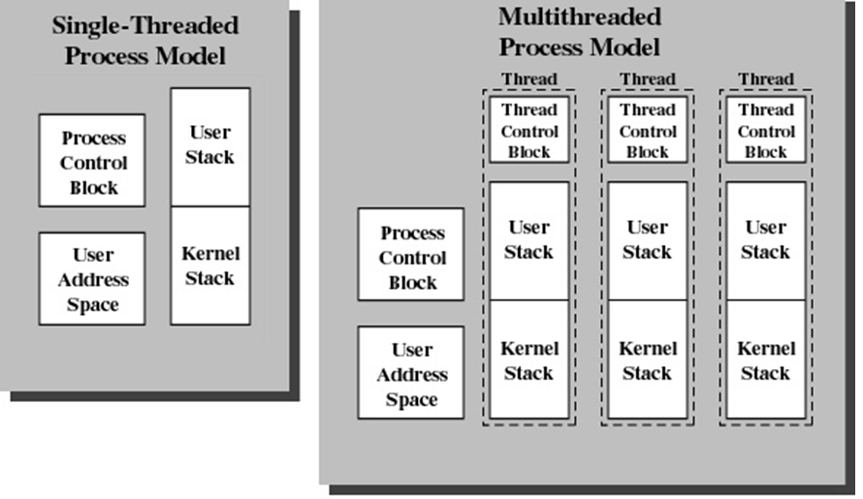
Multitasking vs Multithreading

Slide 5
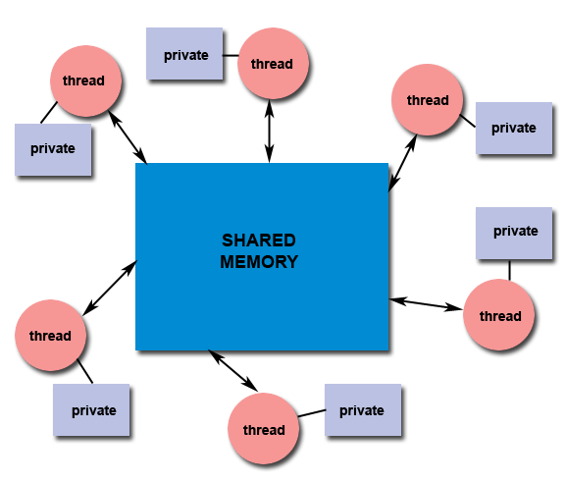
Shared Memory
All threads have access to the same global, shared memory
Threads also have their own private data
Programmers are responsible for synchronizing access (protecting) globally shared data.

Slide 6
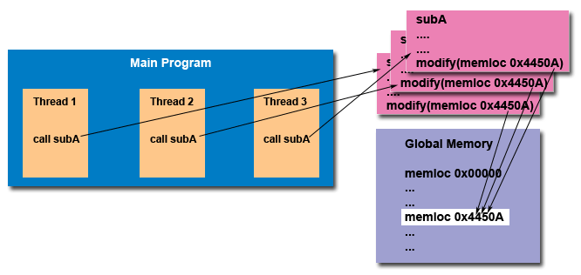
“Thread Safe”

Slide 7
Mutual Exclusion
To protect shared resources from race condition and data inconsistency.
Thread 1 | Thread 2 | Shared Data X
A = X |  | 100
 | B = X | 100
 | B = B + 300 | 100
A = A + 200 |  | 100
X = A |  | 300
 | X = B | 400

Slide 8
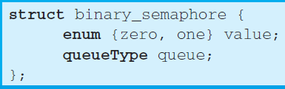
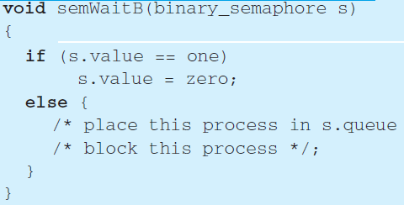
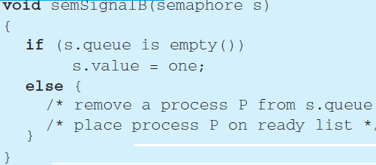
Binary Semaphore

Slide 9
Semaphore
struct semaphore { int count; queueType queue; };
void semWait(semaphore s) { s.count--; if (s.count < 0) { // place this process in s.queue // block this process } } | void semSignal(semaphore s) { s.count++; if (s.count <= 0) { //remove a process P from //s.queue //place process P on ready list } }

Slide 10
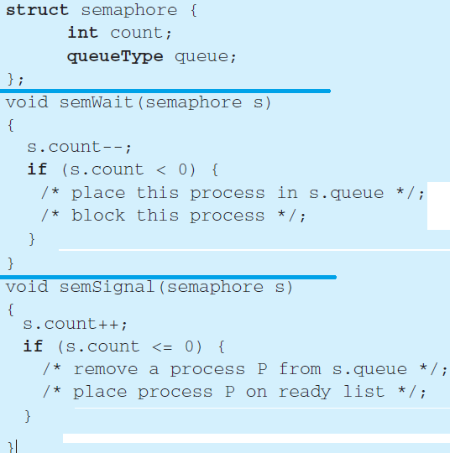
Semaphore

Slide 11

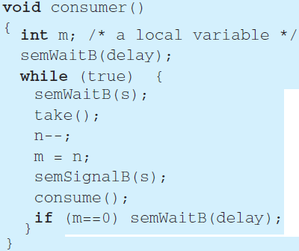
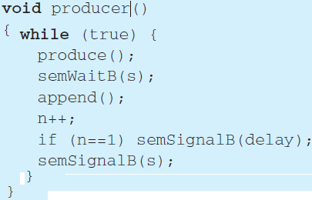
Producer/Consumer(infinite buffer) Problem

Slide 12
Deadlock
Types of shared resources
Reusable
Consumable

Slide 13
Deadlock
Conditions for possible Deadlock
Mutual exclusion(Only one process may use a resource at a time)
Hold-and-wait (A process may hold allocated resources while awaiting assignment of others)
No pre-emption (No resource can be forcibly removed form a process holding it)
Circular Wait
Notes:
All three must be present for deadlock to occur.
13

Slide 14
Deadlock
Ostrich Approach
Do nothing to handle deadlock
Deadlock prevention
Prevent any of the 4 deadlock conditions, liner ordering
Deadlock Avoidance
Avoid circular wait
Deadlock detection & Recovery
Detect circular wait and terminate a process in chain

